Slide 1
Fracture and Creep in an All-Tungsten Divertor for ARIES
Jake Blanchard
University of Wisconsin – Madison
August 2012

Slide 2
Introduction
The ARIES Project is exploring the feasibility of using tungsten as a structural material for plasma-facing components
For now, we are assuming the material is pure tungsten, but alloys may be necessary
This talk addresses two key failure modes that must be addressed by these designs
  Fracture
  Thermal creep

Slide 3
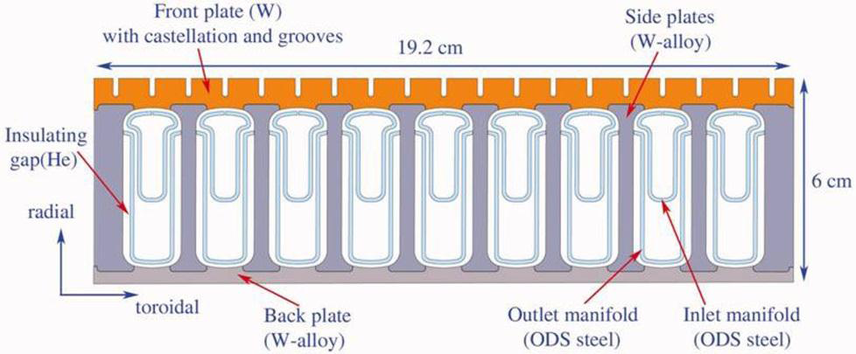
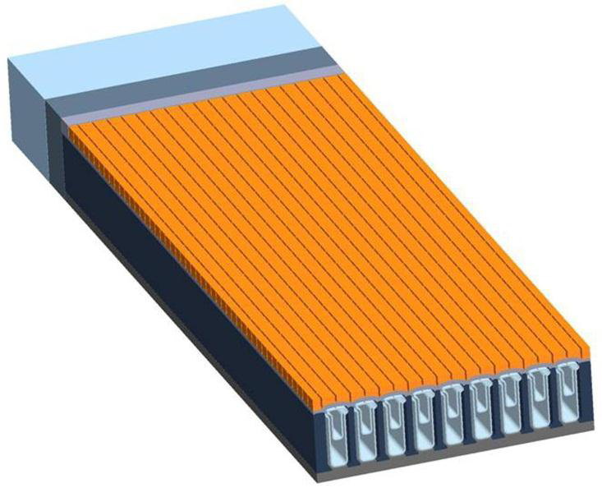
The Design

Slide 4
Major Input Parameters
Parameter | Value | Units
Surface Heat | 11 | MW/m²
Volumetric Heating | 17.5 | MW/m³
Coolant Pressure | 10 | MPa
Bulk Coolant Temperature | 600 | C

Slide 5
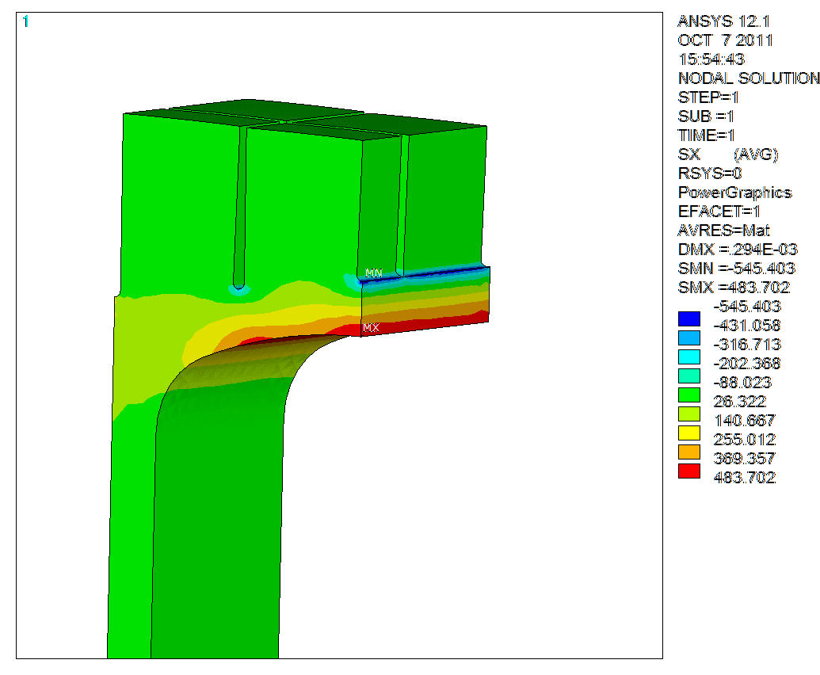
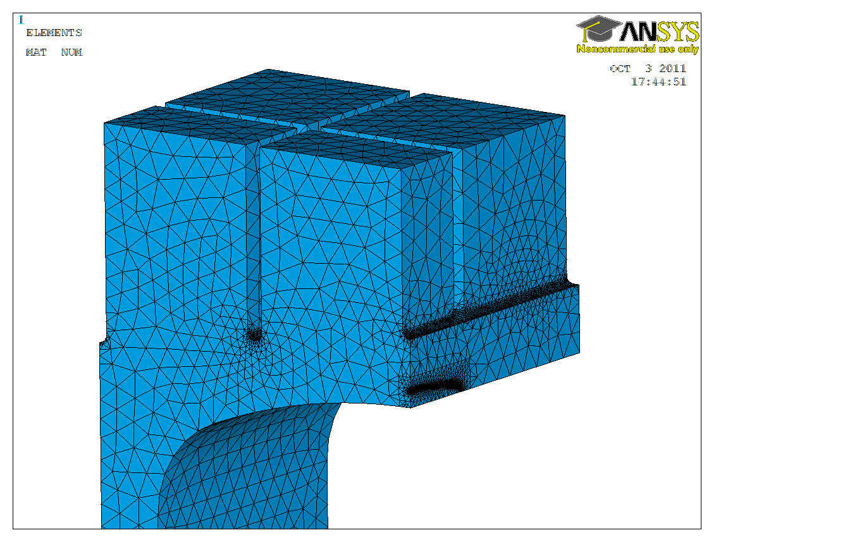
Crack Location
Finite Element Model with Crack on Coolant Channel Surface
Crack-Free Stress State

Slide 6
Fracture Results
Results for Crack Perpendicular to Cracks Shown
Results for Crack on Previous Slide
Results for Crack in Notch (at shutdown)

Slide 7
Effect of Transients
Vary nominal heat flux by +/-20% and apply 20 cycles
No discernible variation below surface
Surface Temperature
Temperature 2.5 mm below surface

Slide 8
Surface Effect of “Small” ELM
Assume 1.95 MJ deposited on divertor surface over 1.2 milliseconds
Melt layer is 20 microns thick

Slide 9
Thermal Creep
Add Thermal Creep Model for Tungsten
Creep rates are excessive at 11 MW/m²
Nominal Heat Flux
Reduced Heat Flux

Slide 10
Design Modifications
Reducing Notch Depth
Varying Surface Heating or Coolant Pressure

Slide 11
Conclusions
We have not identified any “show-stoppers” with respect to an all-tungsten divertor for ARIES
Many uncertainties are still unresolved

